Slide 1
Fleet Management System
Team Name: Colloid
Team Number: 43
Project Supervisor: Mr HJC van Der Westhuizen
Members
Mavuso Mmeli 216016565
Morudu Khanyisile 216090091
Motuba Prince 201302881
Taliwe Thina 216009615

Slide 2
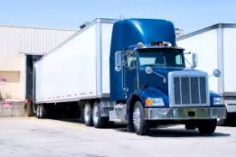
Introduction
Company Background
New Era Commerce
Material handling logistics company
Coal, clinkers and pozzsand
Mr. Mangana, Thokozane

Slide 3
Problem
Problem with current system
Driver Monitoring
DynaFleet limited to 2 trucks
CarTrack is slow and inefficient
Routing Management System does not provide all features needed
Driver Allocation/Assignment
Manual assigning of assignments
Creating Delivery
Loading and Unloading of Materials
Inconsistent reports due to different materials

Slide 4
Solution Statement: Fleet Management System
What it is?
All-in-one solution
Mobile Application for drivers to communicate with
Web Based system for the stakeholders to effectively monitor, assign drivers and generate reports
More user friendly and interactive
Faster

Slide 5
Conclusion

